Slide 1
From Bootstrap to Scale: Optimising Kubernetes Operators
Olga Mirensky - Platform Engineer - ANZ Plus

Slide 2
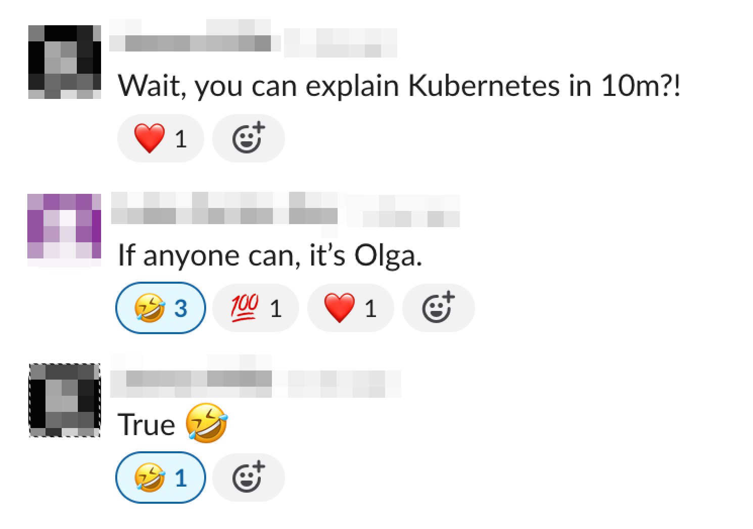
Introduction and Agenda
I am Olga. My teammates
believe that I can explain Kubernetes in 10 minutes.
Can I explain operators in 20 minutes?
Agenda: What is operator and why build one? Operators in ANZ. Scaling challenges. Frameworks, optimisations and what’s new.

Slide 3
What is an Operator and Why Build One
- KRM (Kubernetes Resource Model) + GitOps.
- Continuous reconciliation.
- Codify knowledge, best practices, controls.
Image source github.com/cncf/tag-app-delivery: Operator-WhitePaper_v1-0.md
Notes:
https://github.com/cncf/tag-app-delivery/blob/main/operator-wg/whitepaper/Operator-WhitePaper_v1-0.md
automation pattern that manages the declarative state of an app or infra by continuously monitoring its current status and applying changes as needed to reconcile the system with the desired state. It implements operational knowledge, controls, golden paths and so on.
Operators leverage Kubernetes Resource Model (KRM) pattern together with GitOps practices, makes version-controlled Git repositories single source of truth and enables automated and declarative management of infrastructure.

Slide 4
Operator Stack (Go)
kubebuilder
controller-runtime
Client-go
High-level framework for building Kubernetes operators, provides scaffolding, utilities and patterns
Abstraction for building controllers.
Cache, Manager, Builder, Handler
Official Go client library for interacting with the Kubernetes API. Clientset, Informer, Rate Limiter

Slide 5
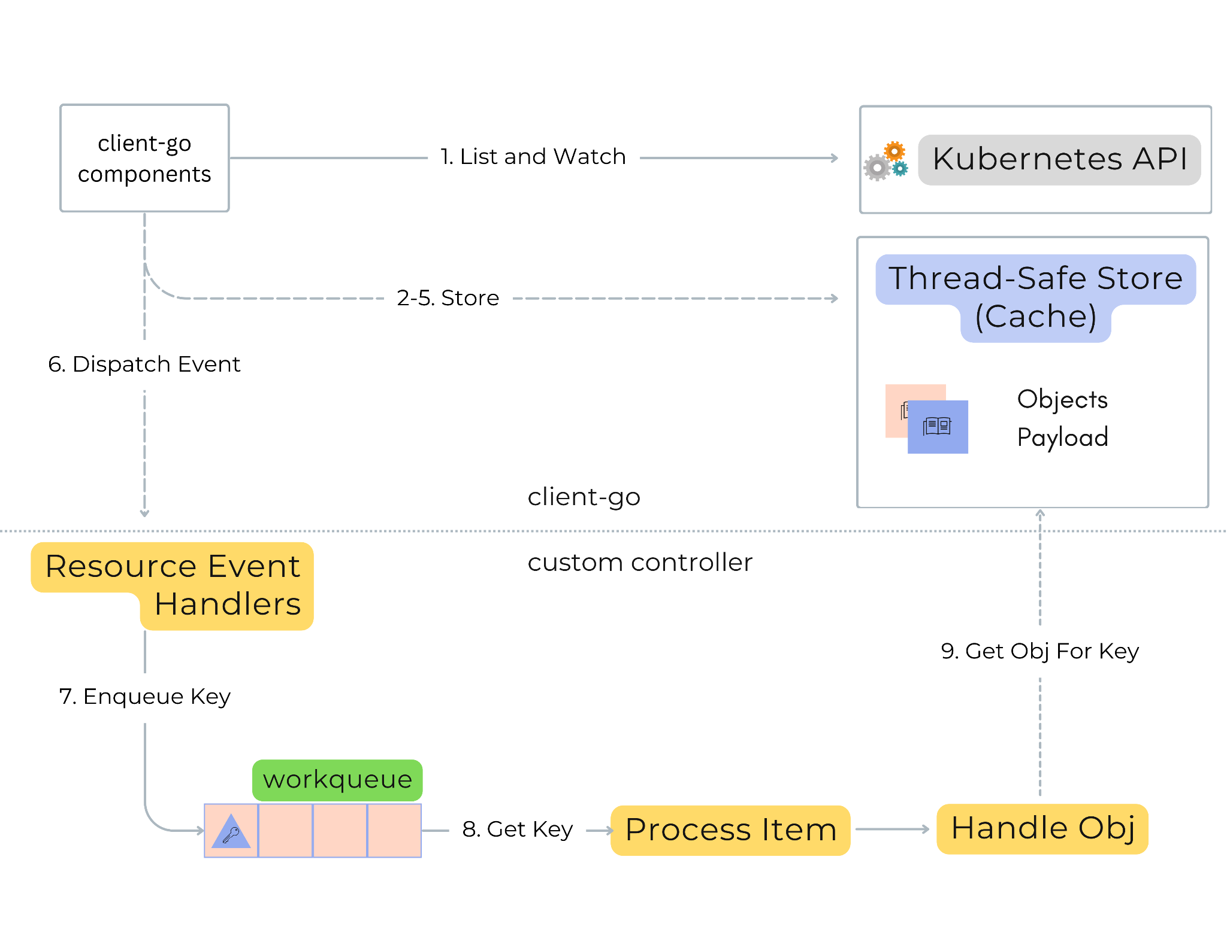
Controllers 101
Simplified version of github.com/kubernetes/sample-controller/blob/master/docs/controller-client-go.md
Notes:
controller-runtime: This is a higher-level library built on top of client-go, designed to simplify the process of writing Kubernetes controllers and operators

Slide 6
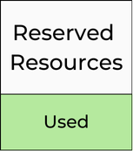
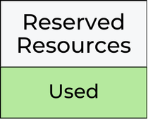
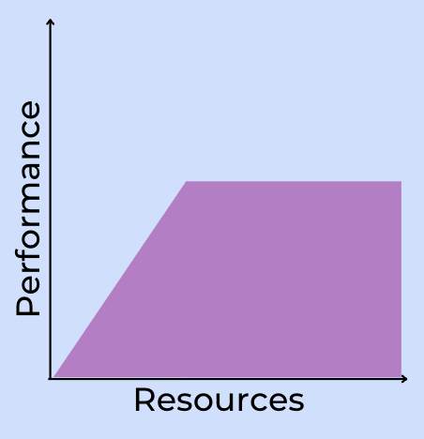
Challenges Scaling Operators
Horizontal Scaling
Leader Election
Solution Attempts
FluxCD Sharding
Vertical Scaling
Concurrency and Rate Limiting
MaxConcurrentReconciles
GroupKindConcurrency
Internal Concurrency
Bottlenecks - rate limiting
Client QPS / Burst
API Server QPS / Burst
External dependencies
pod-1
pod-2
pod-n
Little to no gain in performance beyond some point.
Notes:
I0818 11:08:58.516275 1 request.go:697] Waited for 31.709177138s due to client-side throttling, not priority and fairness, request: POST:https://<IP>:443/api/v1/namespaces/test/configmaps

Slide 7
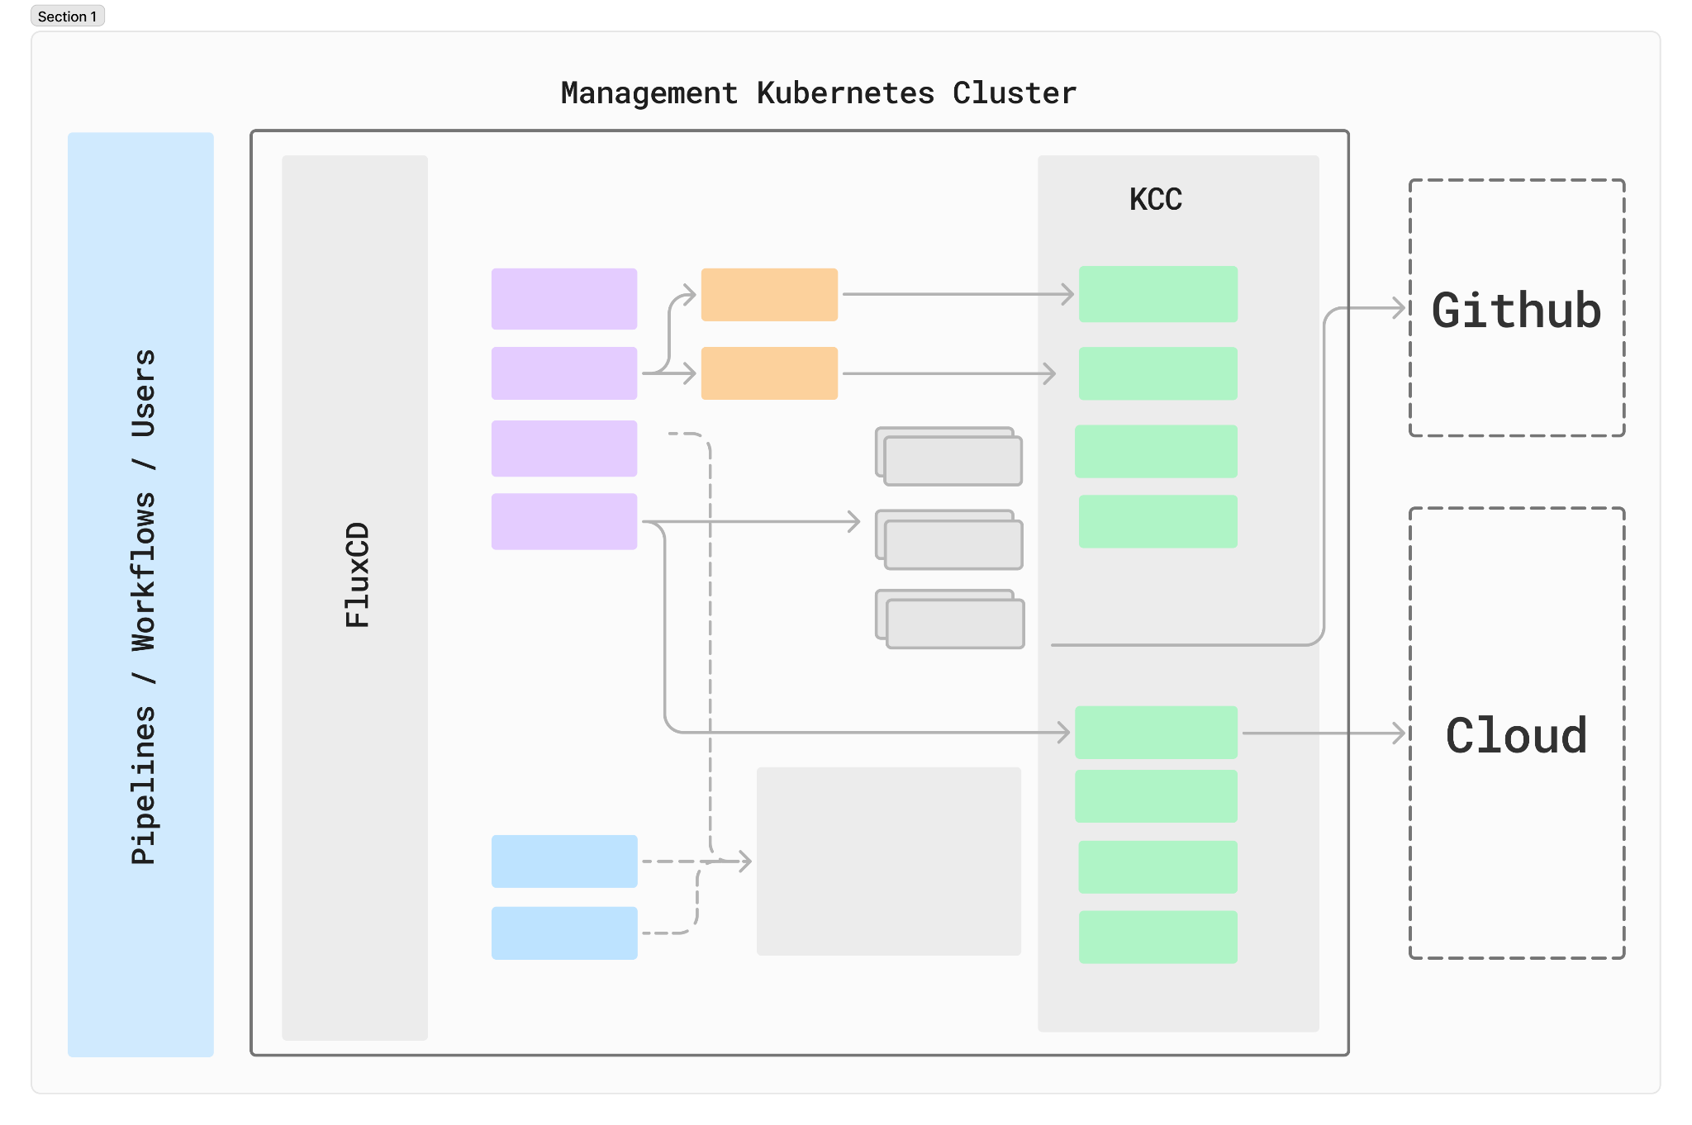
App in 60min - Powered by Operators
Notes:
Egress example
Mention GKE cluster

Slide 8
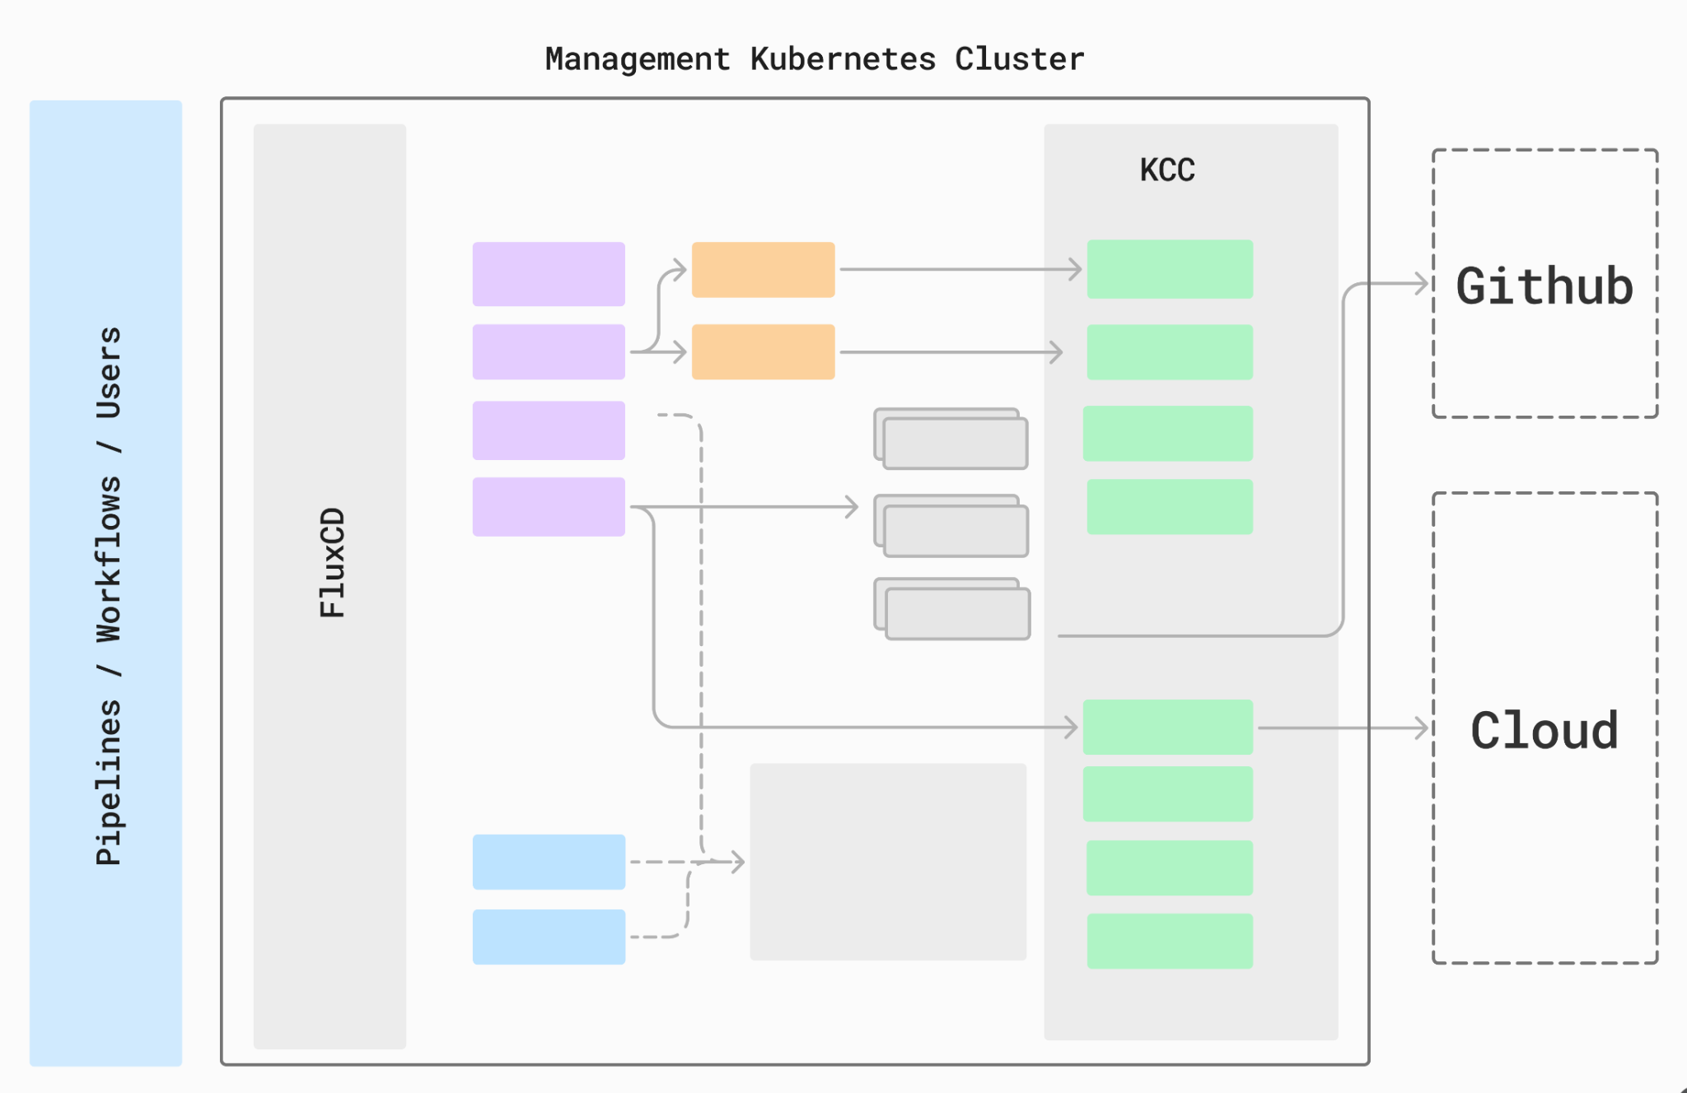
Kubernetes as a Platform Control Plane
Notes:
ADD - one direction load, other - rate limiting potentially unknown undocumented behaviours, in kCC - periodic reconciliation

Slide 9
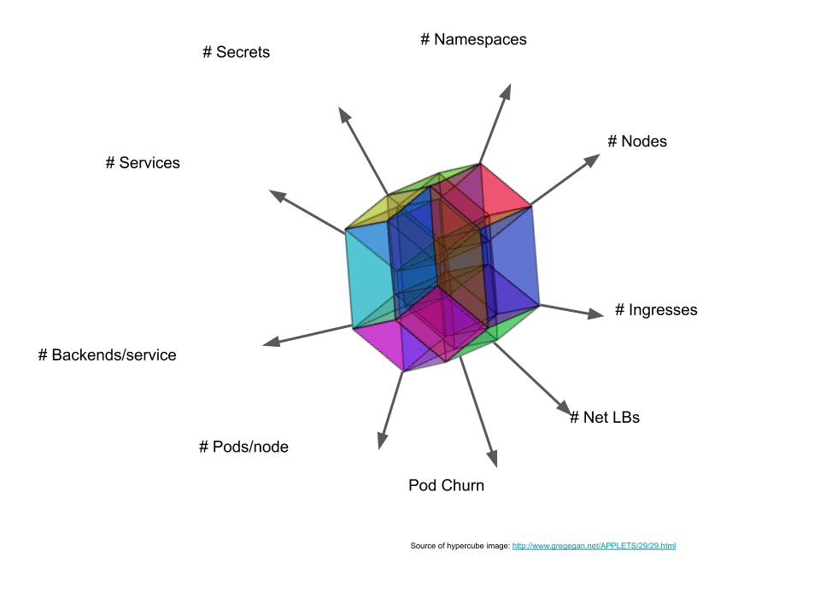
Thresholds and Limits to Inform SLOs
SIG Scalability - Scalability Envelope
Scaling along one axis too far limits other dimensions.
Interdependencies: e.g. number of Services and number of backends in each Service.
Notice the churn as a dimension.

Slide 10
Thresholds Dimensions
Dimension | Kubebuilder Abstraction
Custom Resources | For()
Managed Resources | Owns()
Watched Resources AND / OR | Watches()
Enqueued Resources | Enqueue…() called from Watches
External Events | N/A

Slide 11
Payload Size
2000 x
OR 1 x
apiVersion: mygroup/v1
kind: mykind
spec:
- name: item1
properties: obj
apiVersion: mygroup/v1
kind: mykind
spec:
- name: item1
properties: obj
...
- name: item2000
properties: obj
Example - URLMaps limits
2,000 host rules, path matchers
1,000 path rules per matcher
1,000 Hosts per host rule
…
pathMatcher[].defaultRouteAction.weightedBackendServices[].headerAction.requestHeadersToAdd[]

Slide 12
Capacity Planning - Load Testing
Declarative e2e test.
Templating.
No support for load test (yet?)
Kyverno
Testing Frameworks
kubernetes/perf-tests
SIG Scalability
K8s load testing framework.
Supports CR, measurements, chaos and more.
Cluster Loader 2
Generic resource emulation
Simulate fake/hollow nodes and pods
Emulation
client-gen + fake client
Kubernetes Without Kubelet
(KWOK. SIG Testing)
Kubemark
(SIG Scalability)

Slide 13
Optimisation Opportunities

Slide 14
Fail Fast And Explicitly
Offload work from the operator
Immediate feedback on failure
Cluster hygiene
CEL - Common Expression Language
Example `XValidation` markers translated into CRD (gateway-api)

Slide 15
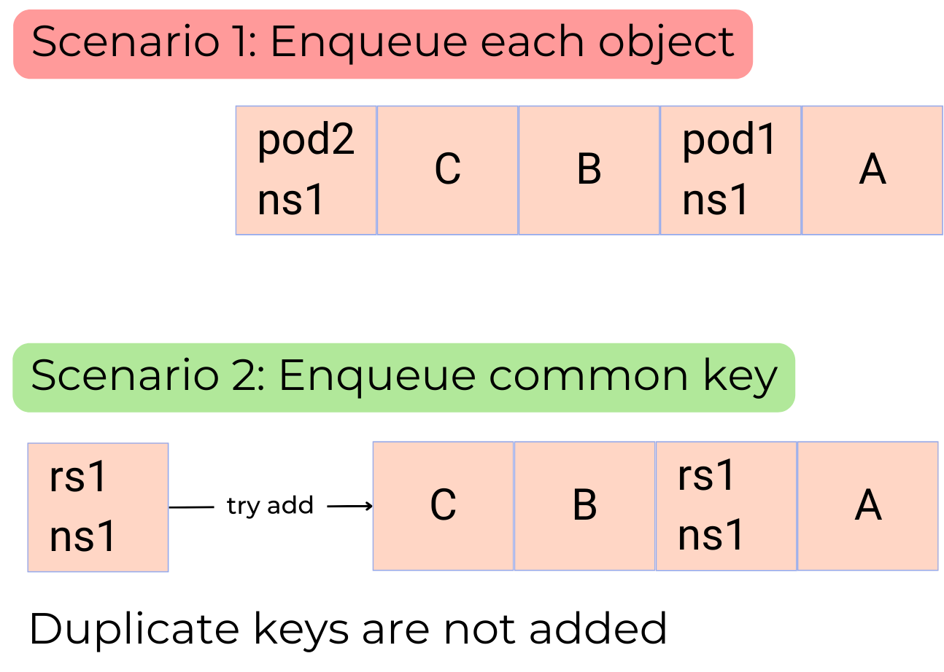
Workqueue Deduplication
Enqueue common key
If reconciliation is exactly the same for different object
Typed Reconciler (experimental)
Controller-runtime - examples/typed/main.go
Convert For to Watch
Named(“myCR”). Watches(v1.myCR,EnqueueCustom).
Notes:
Filter Events - Predicates
GenerationChanged: change in .spec
ResourceVersionChanged: change in .spec or .status
github.com/kubernetes-sigs/controller-runtime/blob/main/examples/typed/main.go

Slide 16
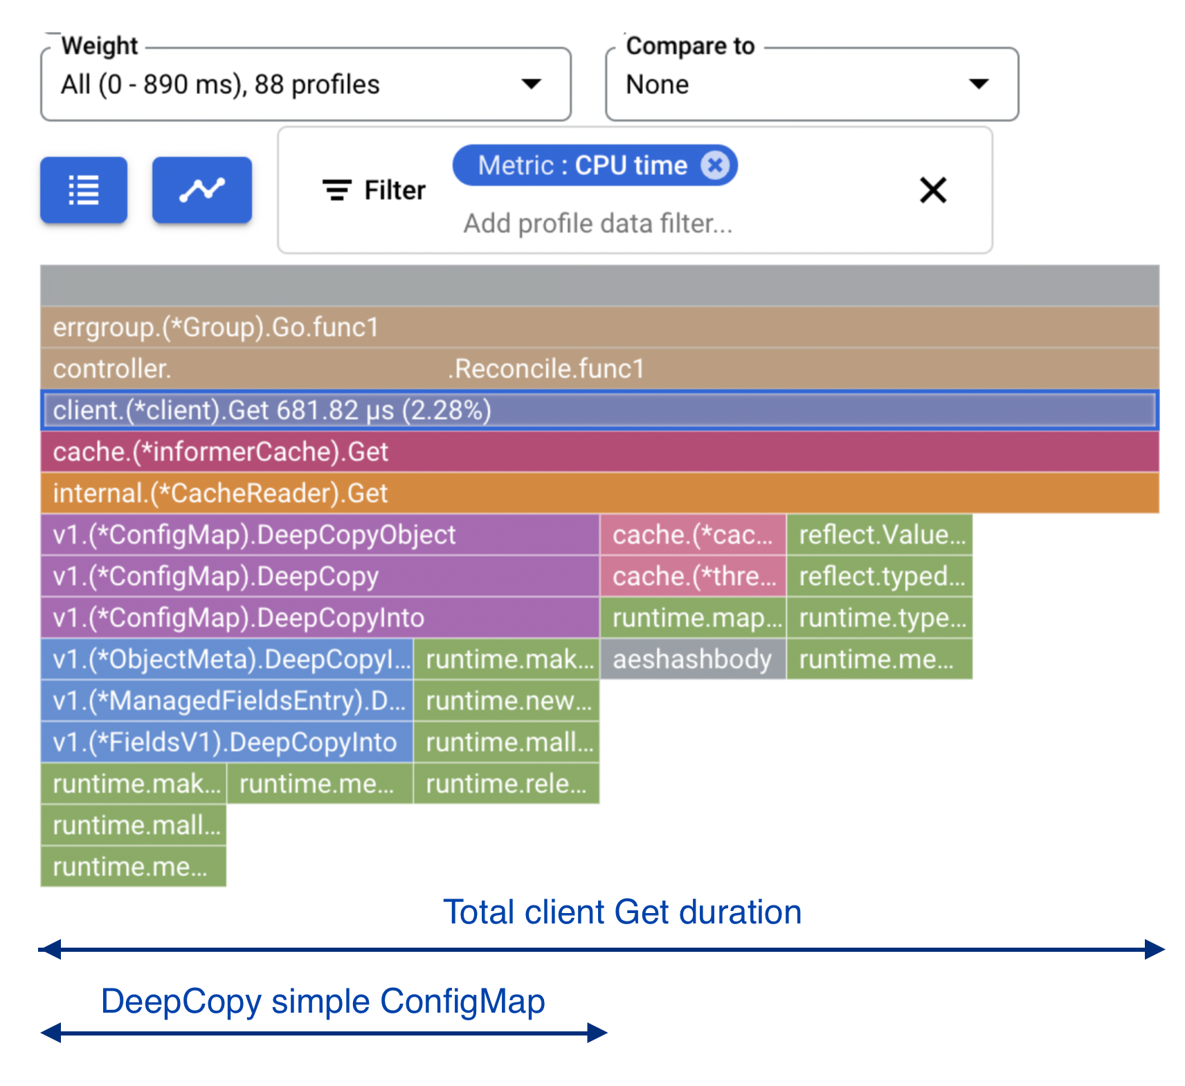
Cache
Less Payload ⇒ less time/CPU in deep copy
`PartialMetadata`
`TransformStripManagedFields`
`UnsafeDisableDeepCopy` (When safe)
Entire Cache
Per Group
Per Object
Avoid Writes
Dirty flag
`CreateOrUpdate`
Field Indexers
speed up retrieval from large cache

Slide 17
What’s next
New Features
Typed Reconciler (experimental, v0.19)
NewQueue
NewCache
Advanced Settings
Controller-runtime source and pkg.go.dev:
Cache Options (cache.go)
Cache Options Design (cache_options.md)
Controller Options (controller.go)
Notes:
Cache options
https://github.com/kubernetes-sigs/controller-runtime/blob/24cc51fde1b37ece947b6ecc4f92ceaa4fe942b5/pkg/cache/cache.go#L135
Controller options
https://github.com/kubernetes-sigs/controller-runtime/blob/b901db121e1f53c47ec9f9683fad90a546688c3e/pkg/controller/controller.go#L69
https://pkg.go.dev/sigs.k8s.io/controller-runtime/pkg/controller#TypedOptions
Cache Options Design
https://github.com/kubernetes-sigs/controller-runtime/blob/main/designs/cache_options.md
Writing Controllers
https://github.com/kubernetes/community/blob/master/contributors/devel/sig-api-machinery/controllers.md#readme

Slide 18
Questions & Feedback

