Slide 1
Managing Kubernetes Clusters on Spot Instances
Olga Mirensky, Platform Engineer, ANZx
Notes:
Hi everyone, My name is Olga, I’m Platform Engineer in ANZx.
We are the people behind the
new digital bank known as ANZ Plus launched last year
It’s built on public clouds and Cloud Native technologies with k8s being a big part of our platform and today I’ll share some insights and learnings from our spot instances journey

Slide 2
Agenda
Motivation for Spot Instances
Reserved Instances (RI), Committed User Discounts (CUD), etc.
Spot Instances
Focus on underlying VMs cost, not workload right-sizing
Managing k8s and applications running on Spot
Unknown unknowns
Takeaways
Notes:
Spot instances is not THE way to save money, it is one of the ingredients in a cost-optimisation strategy. I won’t talk about workload right sizing, instead will focus only on optimising the cost of the underlying VMs.
I’ll start by explaining the motivation for Spot instances comparing it with other compute purchase options. Then we talk about preparing applications and the cluster for this rollercoaster and what unexpected twists we’ve encountered

Slide 3
Compute Backed by Availability SLA
On-demand
Resource Based
Reserved Instances (RI), Convertible, Committed Use Discounts (CUD)
AWS: 1yr - 40%, 3yr - 60%
GCP: 1yr - 37%, 3yr - up to 57% / 70%
Spend Based
AWS Saving Plans: 3yr - up to 72%
GCP Flex CUD: 1yr - 28%, 3yr - 46%
Long-term commitment & doesn’t cover 100% of your compute
Notes:
So what options do we have for compute resources.
On-demand is the most straight forward model, once the VM is provisioned it is guaranteed to be available to you until you switch it off and you are only billed for the time used.
Very flexible and easy but the bill will go through the roof very quickly if you are using only this model.
The next step are the discounts offered by cloud providers in exchange for your commitment.
They can be either resource based or spend based
70-72 is a really amazing discount, why would you even want the headaches that come with unreliable infra like spot?
—--
This slide gives very high level overview of compute capacity purchase options. On-demand requires no commitment from your side and you only billed for amount used. You are guaranteed to have the instance available until you release it. Easy
We all know too well that this becomes extremely expensive very quickly.
Cloud providers give you options to save money if you can commit to long term of 1 or 3 years and be specific about either resource type you want to use or amount of money you are committed to spend.
Btw this is not even a 10,000 feet overview it is a view from stratosphere and AWS and GCP are just examples for illustration purposes only. The best you can get to is around 70 percent, which is a really good number. The problem is it requires long term and specific commitment from your part and it doesn’t cover 100% of your infrastructure because your production have certain patterns and your baseline over 3 years is hopefully grows, your infrastructure requires different compute types, and don’t forget that you also need to pay for non-production which has a whole life of its own.
This is where spot comes into play to complement for this “excess” that is not covered by this commitments.

Slide 4
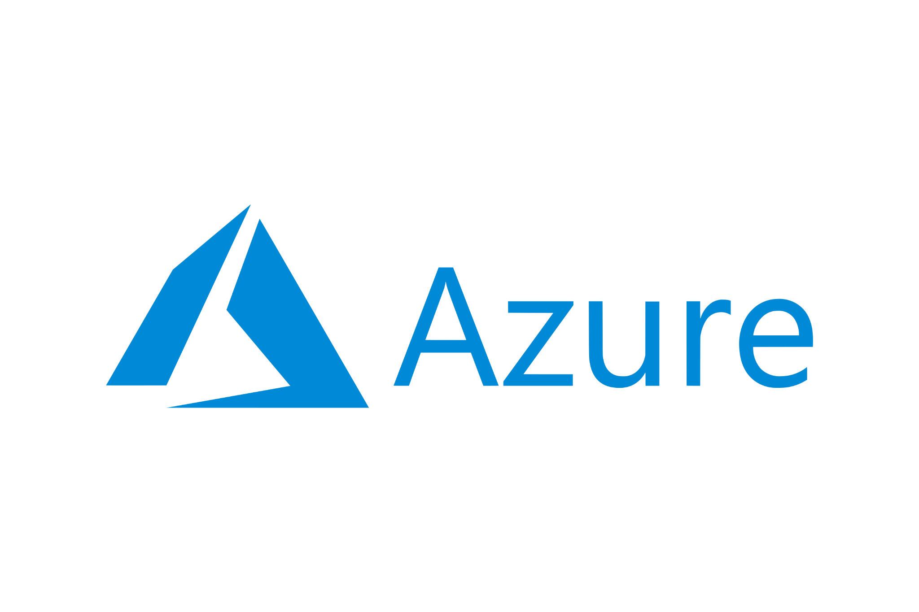
Spot Instances 10,000 Foot Overview
Discount | 60 - 91% | 70 - 90% | Up to 90%
Notice | 30 sec | 2 min, Rebalance recommendation | 30 sec
Price Update | Once a month | Can be frequent | Variable
Options (not exhaustive) | One size fits all | Price and/or capacity optimised | Set your own max price
Price Insights | Difficult. API, Cost table | Easy. `aws ec2 describe-spot-price-history` Spot instance advisor | Portal price/eviction history, API
Notes:
Spot is provisioning model of Compute Capacity where the resources are provisioned out of excess capacity of the data center.

Slide 5
Common Patterns
Notes:
Ok, so we want to incorporate spot instances in our clusters - what are the main challenges we need to solve?
Preemptions - the fact that nodes go down unexpectedly and quickly
Capacity availability
We’ll look at these concerns from application context and from k8s context

Slide 6
Handling Spot Preemptions
✅ Stateless ✅ Interactive web applications
✅ Batch processing jobs
⚠️ Stateful ⚠️ CICD (e.g. terraform apply)
Application Graceful Shutdown
SIGTERM handler
Stop accepting new work
Finalise in-flight work
Preemption notice: 30 sec
K8s Node Graceful Shutdown
Node NotReady
SIGTERM propagation
Workload pods
25 sec
System pods
5 sec
Notes:
On application side of things first we need to identify which are the lucky ones that get admission to this rollercoaster
Stateless, interactive, quick to start/stop ….
Next we need to implement them in such a way that they exit cleanly with minimal noticeable impact for your service end-users
This is done with the help of SIGTERM

Slide 7
Spot Capacity Management in k8s
k8s nodepools:
nodeAffinity:
requiredDuringSchedulingIgnoredDuringExecution:
nodeSelectorTerms:
- matchExpressions:
- key: nodepool-name
operator: In
values:
- pool-one-spot
- pool-one-on-demand
preferredDuringSchedulingIgnoredDuringExecution:
- weight: 100
preference:
matchExpressions:
- key: cloud.google.com/gke-spot
operator: In
values:
- true
pool-one- on-
demand
pool-one-spot
pool-two- on-
demand
pool-two-spot
…
Automatically labelled:
karpenter.sh/capacity-type: spot
eks.amazonaws.com/capacityType: SPOT
cloud.google.com/gke-spot: true
Notes:
On the cluster level we want to ensure continuity regardless of preemption rate and spot availability.
This can be done by implementing a higer level nodepools that consist of spot and on-demand parts.
We need to make application treat this higher level nodepool as standalone pool, separate from other nodepools
and at the same time allow the flexibility to fall in either part of this nodepool depending on its current state.

Slide 8
Capacity Management in k8s (cont)
Requirements
Pending pods: nodepools, affinities, etc
Constraints
available capacity
# https://github.com/kubernetes/autoscaler
# higher number - higher priority (not %)
apiVersion: v1
kind: ConfigMap
metadata:
name: cluster-autoscaler-priority-expander
namespace: kube-system
data:
priorities: |-
10:
- .*on-demand.*
50:
- .*spot.*
Cluster Autoscaler Priority-based expander,
GKE Cluster Autoscaler is price-optimised, Karpenter,
Managed Dataplane,
…
Notes:
How do we manage the nodes that go in these nodepools
The Cluster Autoscaler, maintained by k8s SIG Autoscaling, has a concept of Expanders
Expander is a set of strategies that selects which nodepool to scale up based on requirements of pending pods in case when there are multiple suitable nodepools

Slide 9
Unexpected Twists
Notes:
In theory, theory and practice are the same. In practice they are not
Let’s look at the curve balls that reality threw at us

Slide 10
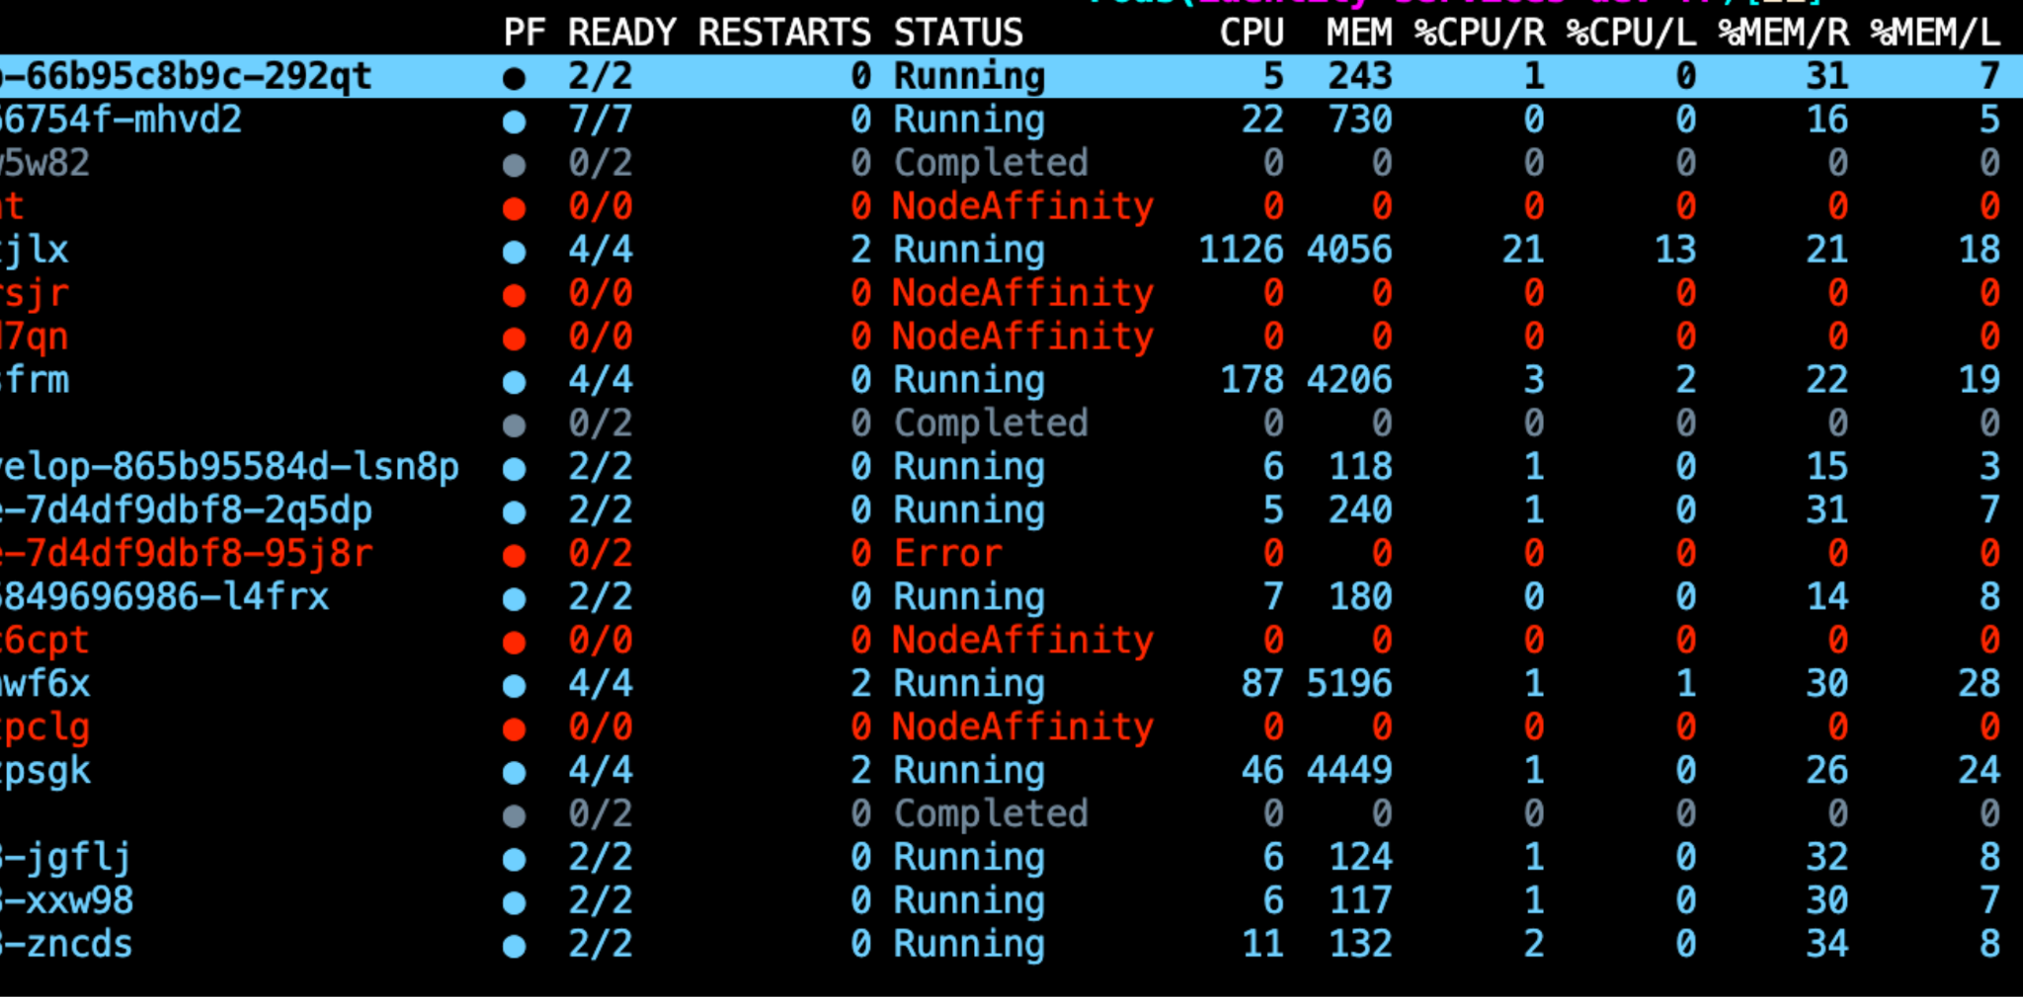
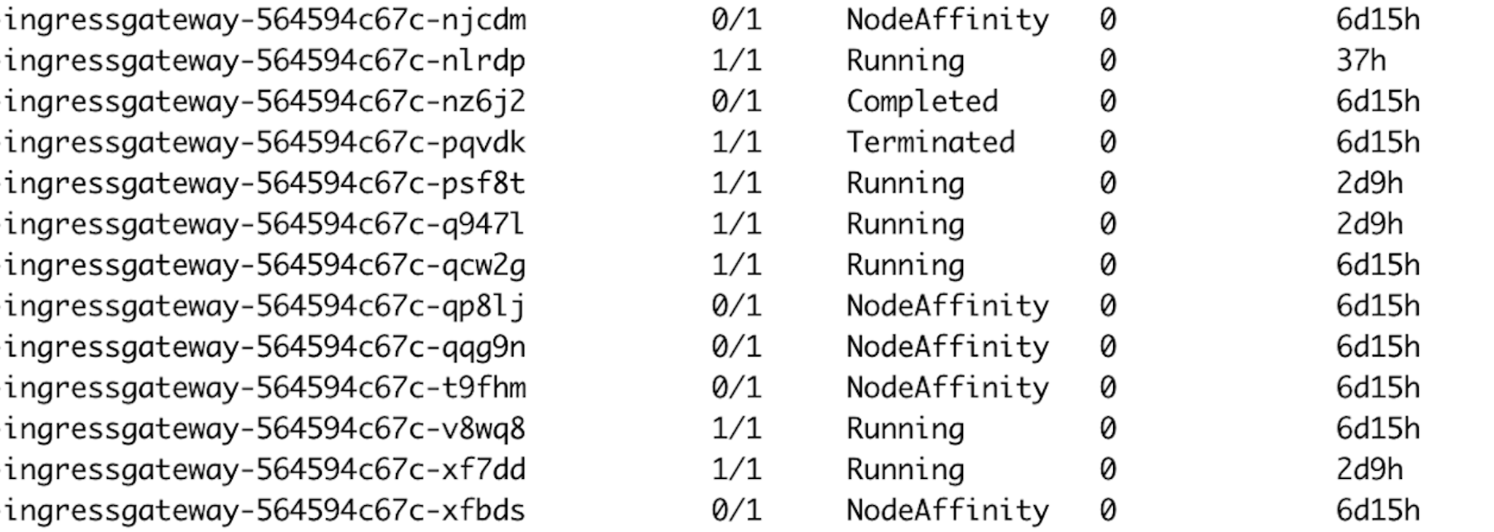
We Broke Everything (but not really)
⁉️
OutOfpods, Error, NotReady, ContainerStatusUknown, NodeShutdown, Terminated, Init:ContainerStatusUnknown and more!! 😵‍💫
🤔
Notes:
These are only little snippets of a namespace, deployment or a cluster might NOT look like a big deal but in large environments it becomes quite intense and confusing.
Take for example google cloud console - isn’t it a tiny bit unsettling for a cluster running on spot (without the fallback at the time) to have most of its deployments in Out Of CPU state?
Isn’t it a little bit confusing to find ingressgateway pods in “Completed” state?

Slide 11
NodeAffinity
$ kubectl get pod $name -o yaml … status:
message: Pod Predicate NodeAffinity failed
phase: Failed
reason: NodeAffinity
Warning NodeAffinity 41m kubelet Predicate NodeAffinity failed
Warning FailedMount 2m21s (x3870 over 5d10h) kubelet MountVolume.SetUp failed for volume . "xxxx": object "<namespace>"/"<name>" not registered Warning FailedMount 26s (x28 over 41m) kubelet MountVolume.SetUp failed for volume . kube-api-access-12345: object "my-ns"/"kube-root-ca.crt" not registered

Slide 12
Additional Challenges
Preemption and availability is only the beginning.
Preempting many busy nodes at once causes many pods to start at the same time one a new node
OutOfcpu
OutOfpods
Automatic VM reclamation causes VM replacement for the same node and kubelet restart
NodeAffinity
Notes:
there's more to Spot than meets the eye and there are additional challenges we have to deal with. As I deep dived into NodeAffinity and other failed pods I saw at least two main sources for these errors

Slide 13
How’s This Deployment Doing?
$ kubectl get pod -l k8s-app=my-app
NAME READY STATUS RESTARTS AGE
my-app-564594c67c-njcdm 0/1 NodeAffinity 0 6d15h
my-app-564594c67c-nlrdp 1/1 Running 0 37h
my-app-564594c67c-nz6j2 0/1 Completed 0 6d15h
my-app-564594c67c-pqvdk 1/1 Terminated 0 6d15h
my-app-564594c67c-psf8t 1/1 Running 0 2d9h
my-app-564594c67c-qcw2g 1/1 Running 0 6d15h
my-app-564594c67c-qp81j 0/1 NodeAffinity 0 6d15h
my-app-564594c67c-qqg9n 0/1 NodeAffinity 0 6d15h
my-app-564594c67c-t9fhm 0/1 NodeAffinity 0 6d15h
my-app-564594c67c-v8wq8 1/1 Running 0 6d15h
$ kubectl get deploy -l k8s-app=my-app
NAME READY UP-TO-DATE AVAILABLE AGE
my-app 4/4 4 4 48d
Failed pods: don’t consume resources, don’t count towards pods per node, don’t count in controllers. Just objects in etcd.
The only real harm these pods cause is confusion.
$ kubectl get pods --field-selector status.phase=Failed
Notes:
But let’s step into developer’s shoes before we knew all what I just talked about.
They deploy complex stacks consisting of multiple deployments, and when their pipeline timeouts or fails for whatever reason they’ll go to the k8s client and day after day they’ll see this.
How can you reason about the deployment like this? Is it doing okay or is it broken? Is broken because of Spot or misconfiguration error? What are these nodeaffinities and why are they stuck? If all my deployments look like this how do I even know which deployment is actually having a bad time? We are not providing amazing Developer Experience here, even if there is no real impact to workloads.

Slide 14
Mitigations and Takeaways

Slide 15
Monitoring and Alerting
Platform Critical User Journeys (CUJ) and SLOs
Confidence for platform consumers and Platform Engineering around platform stability.
Alert on error budget burn
Monitoring
Rate of preemptions - insights and troubleshooting, but don’t alert.
Pod/node churn
Notes:
Monitoring
You can plot the preemptions by cluster/region/nodepool - for curiosity and maybe help developers to self-diagnose if instability in the environment caused by preemptions or something else.
There is no point alerting on this - because preemptions are inevitable and there is nothing that you can do to improve the rate of preemptions.
What is important is to

Slide 16
Descheduler
https://github.com/kubernetes-sigs/descheduler
Finds pods that can be moved according to configurable policies and evicts them.
Example policies useful in Spot clusters:
Remove Failed pods
Rebalance Availability Zones
Spread pods across nodes

Slide 17
Free Chaos Engineering
k8s best practices applicable to on-demand and crucial on Spot:
Replication
Spread across zones and nodes (TSC[1], pod AntiAffinity)
Graceful shutdown
Probes, especially StartUp
Tier applications by priority
PDBs. Don’t protect from Spot preemptions, but improve overall reliability
[1] new features: https://kubernetes.io/blog/2023/04/17/fine-grained-pod-topology-spread-features-beta/
Notes:
By definition there will be more movement in spot clusters in terms of pods and nodes. The good news is that k8s is designed for dynamic environments, it is an amazing and powerful platform that enables you to build resilient applications at scale. You just need to harness this power really really well. There is nothing groundbreaking on this slide and it’s the beauty of it. Replication, topology spread, .., at a minimum.
With Spot not only you save a ton of money you also get a free treadmill to exercise your platform and apps on and a catalyst to implementing best practices including on clusters that are not spot.

